Slide 1
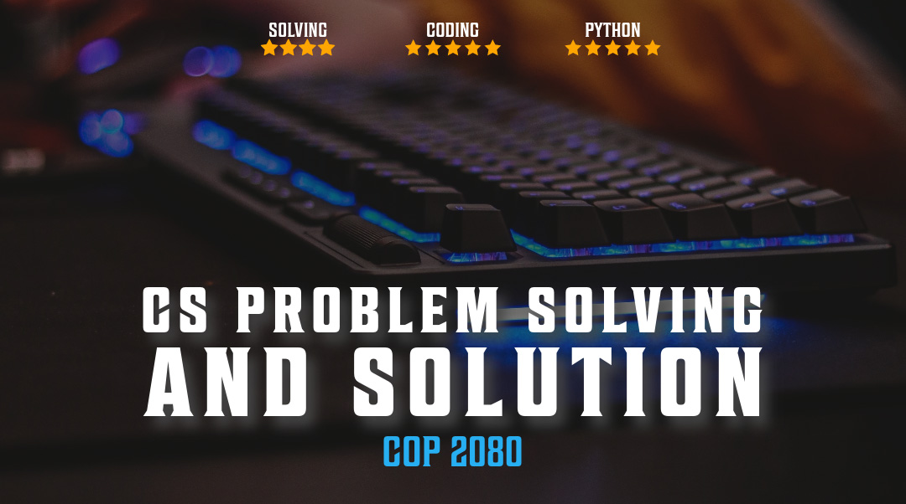

Debugging

Slide 2

Overview
Debugging
Logging
Profiling

Slide 3
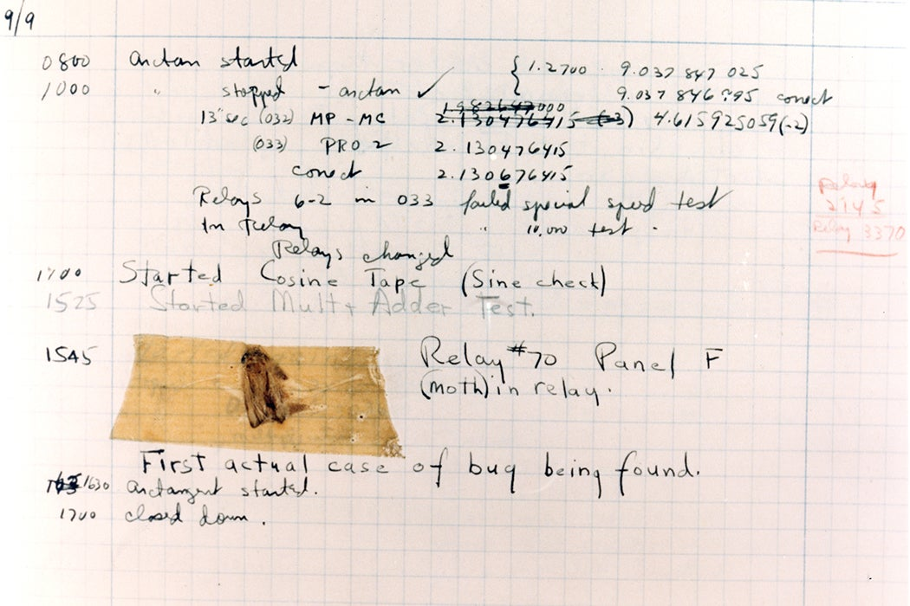
The need for debugging
Popular Libraries
pdb
ipdb
pudb
debugpy
pytest
doctest
Process of finding and fixing errors in software code.
Essential part of the software development process
Ensure that the software is reliable and meets the requirements of the users

Slide 4



Beneifts of debugging
Improved software quality: Debugging helps to identify and fix errors in the software
01
Reduced cost of development: by preventing errors from being introduced into the software while developing
02
Improved user satisfaction: oftware is reliable and meets the requirements of the users
03
Increased productivity: When software is reliable and easy to use, developers can be more productive
04

Slide 5


Debugging with print
done = False while not done: sentinel = str.upper(input(f'Enter Q for quit or any other key to compute tax ')) if sentinel == 'Q': done = True print(sentinel,done) continue def calculate_price_with_tax(p, t): print(p,t) return p * (100 + t) / 100 def get_inputs(): price = float(input('What is the price ')) print(price) tax = float(input('What is the tax rate? ')) print(tax) return calculate_price_with_tax(price,tax) #print(calculate_price_with_tax(price, tax)) print('The calculated price is ',get_inputs())
print(f’variable x is {x}’)
Printing key variables at different points
May not be effective in all dev or prod environments
Need access to a console output
Possible to forget to remove debugging print() statements

Slide 6


Debugging with custom function
Custom function to debug to console
Unique naming simplifies removing after development
Msg is printed when calling function
Separator can improve readability
Implement function into existing code
This is not the same as DEBUG in loggin
# custom.py def debugg(*msg, print_separator=True): print(msg) if print_separator: print('-' * 40) debugg('Data is ...') debugg('Different', 'Strings', 'Are not a problem') debugg('After while loop', print_separator=False)

Slide 7

Standard pde debugger
# pdebugger.py # d comes from a JSON payload we don't control import pdb pdb.set_trace() # breakpoint() d = {'first': 'v1', 'second': 'v2', 'fourth': 'v4'} # keys also comes from a JSON payload we don't control keys = ('first', 'second', 'third', 'fourth') def do_something_with_value(value): print(value) for key in keys: do_something_with_value(d[key]) print('Validation done.')
3 ways to use pde
In code: import pde; pdb.set_trace()
In code: breakpoint()
cmd line: python -m pdb myscript.py
Module pdb defines an interactive source code debugger for Python programs.
Supports setting (conditional) breakpoints and single stepping at the source line level, inspection of stack frames, source code listing, and evaluation of arbitrary Python code

Slide 8
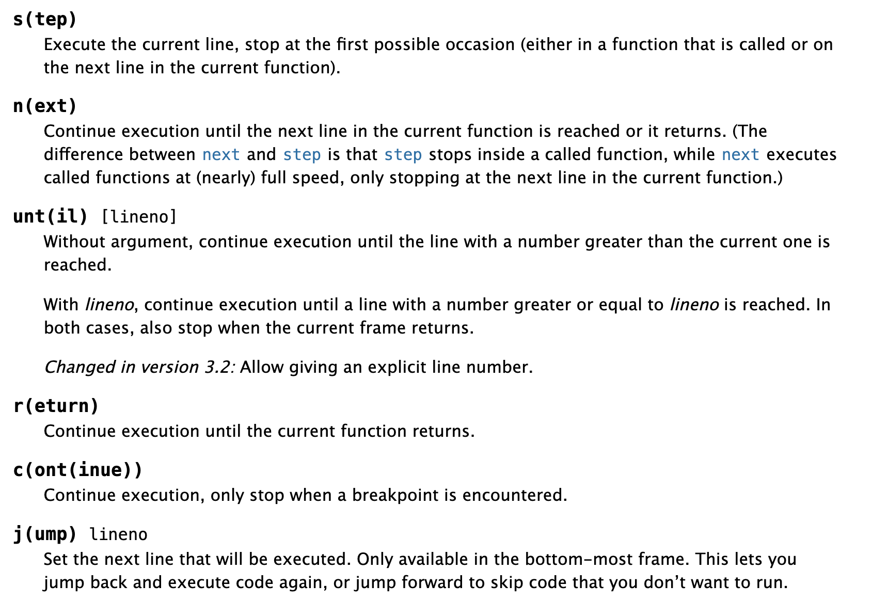
pde commands
https://docs.python.org/3/library/pdb.html

Slide 9
Using logging module
Logging is performed by calling methods on instances of the Logger class.
Each line you log has a severity level associated with it.
Anything below the logger's level will be ignored.
https://docs.python.org/3/howto/logging-cookbook.html
import logging # Create a logger logger = logging.getLogger('my_logger') logger.setLevel(logging.DEBUG)
Level | Function | Val
NOTSET | Default | 0
DEBUG | Detailed info, only used for debugging | 10
INFO | Info on whats happening in program | 20
WARNING | Warn of unexpected occurrence of problem | 30
ERROR | Inform of errors | 40
CRITICAL | Serious errors | 50

Slide 10
Using logging module
# log.py import logging #with open('L14.log','w') as fw: # fw.write('This is a new log file\n') print('hello') logging.basicConfig( filename='L14.log', level=logging.DEBUG, format='[%(asctime)s] %(levelname)s: %(message)s', datefmt='%m/%d/%Y %I:%M:%S %p') mylist = [1, 2, 3] logging.info('Starting to process `mylist`...') for position in range(4): try: logging.debug( 'Value at position %s is %s', position, mylist[position] ) # except IndexError: except Exception: logging.exception('Faulty position: %s', position) logging.info('Done processing `mylist`.')
Start by logging info message that states about to process list.
Inside loop, log the value at each position (use the debug() function to log at the DEBUG level).
We use debug() here so that we can filter out these logs in the future (by setting the minimum level to logging
Set logging.level=INFO to disable DEBUG messages
IndexError will call logging.exception(), which logs at the ERROR level, also outputs the exception traceback
Log another info message to show complete

Slide 11
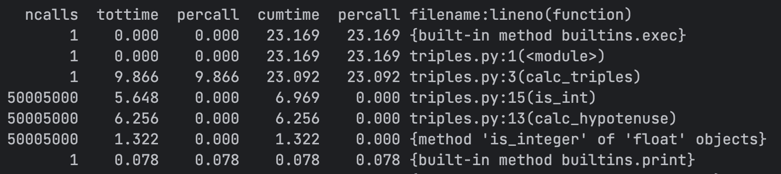
Profiling Python
# run with python -m cProfile profiling/triples.py # profiling/triples.py def calc_triples(mx): triples = [] for a in range(1, mx + 1): for b in range(a, mx + 1): hypotenuse = calc_hypotenuse(a, b) if is_int(hypotenuse): triples.append((a, b, int(hypotenuse))) return triples #def calc_hypotenuse(a, b): # return (a**2 + b**2) ** .5 def calc_hypotenuse(a, b): return (a*a + b*b) ** .5 def is_int(n): # n is expected to be a float return n.is_integer() triples = calc_triples(10000) print(triples)
Used for solving performance issues
Included profile and cProfile in std library

Slide 12
Measuring with timeit
timeit.timeit(stmt='pass', setup='pass', timer=<default timer>, number=1000000, globals=None)
Module timeit provides a simple way to time small bits of Python code.
It has both a Command-Line Interface as well as a callable one
CLI
(venv) MC-QW2TW3QYHG:bin cnavarro$ python3 -m timeit -s 'a=3; b=3' '(a**2 + b**2) ** .5'
5000000 loops, best of 5: 68.3 nsec per loop
import timeit
timeit.timeit(lambda: "-".join(map(str, range(100))), number=10000)
0.0641811250243336
Callable

Slide 13
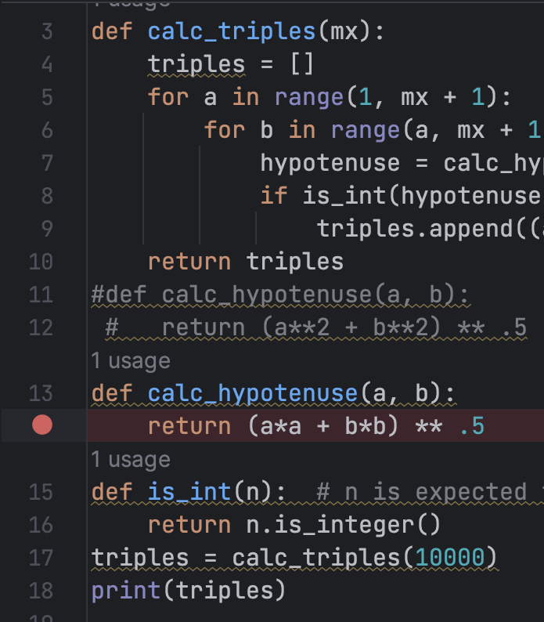

To Debug in Pycharm
To start debugging, you have to set a breakpoint first. The debugger will stop just before executing the line with the breakpoint, and you will be able to examine the current state of the program.
Click on number in gutter to set a breakpoint

Slide 14
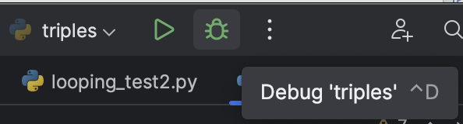
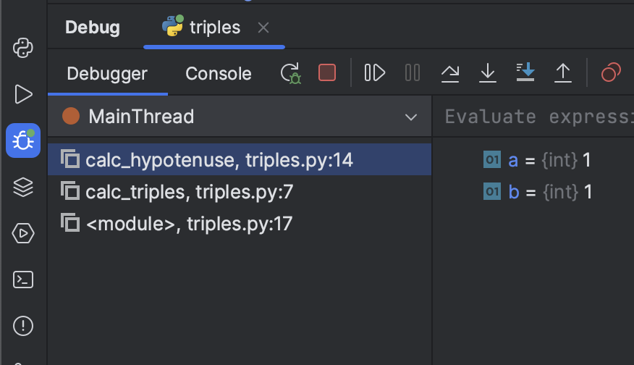

To Debug in Pycharm
Click the bug icon or right click in editor and select Debug triples.py
PyCharm starts a debugging session and shows the Debug tool window.
Press a followed by
The debugger will execute the script and stop at the breakpoint. The Threads & Variables tab of the Debug tool window will open.
Expand self to examine the current values of the variables:

Slide 15
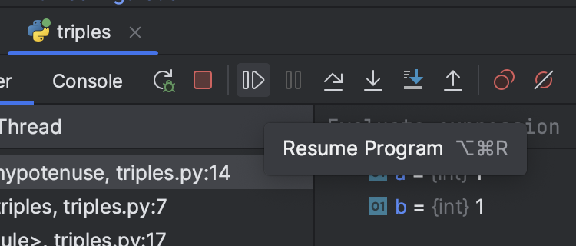
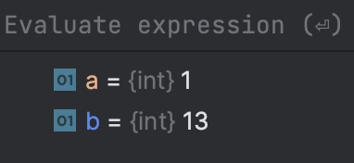

To Debug in Pycharm
Now click resume (Resume) and switch to the Console tab in the Debug tool window. And code will procede
Go back to the Threads & Variables tab and examine the variables.
Every time you press resume, the variables will update

Slide 16
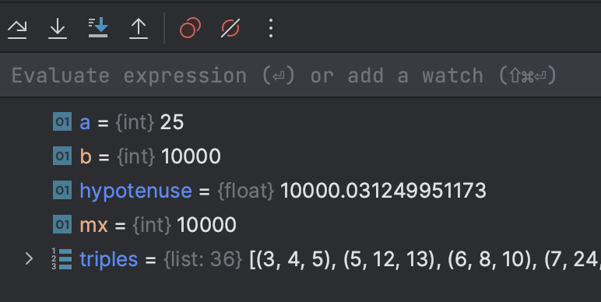
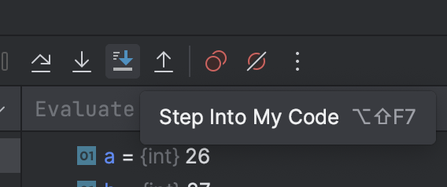


Stepping
click the Step Into button , you will see that the debugger goes into the file
Click the Step Over button App expui run step over and see the blue marker moving to the next line of code
Click the Step Into buttonStep into icon, you will see that the debugger goes into the file.
Step Into may take you into library classes.
To avoid, use Step Into My Code instead

Slide 17
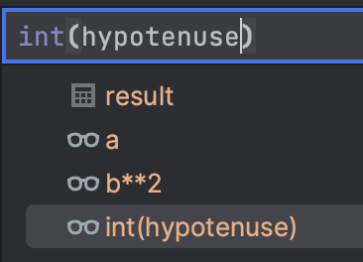
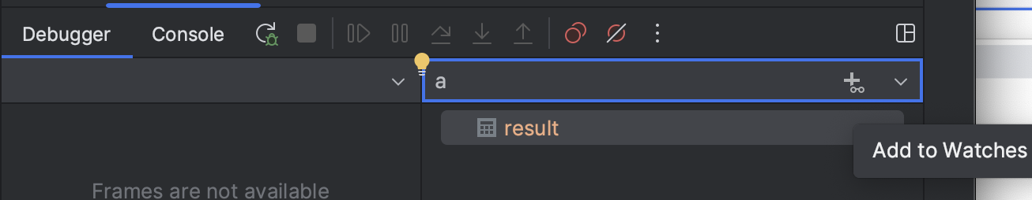



Watching
click the Step Into button , you will see that the debugger goes into the file
You to watch any variable. Just type the name of the variable you want to watch in the Evaluate expression or add a watch field under the toolbar on the Threads & Variables tab.
For example, my_car.time. Note that code completion is available here. Then clickThe Add button at the right edge of the field.

Slide 18
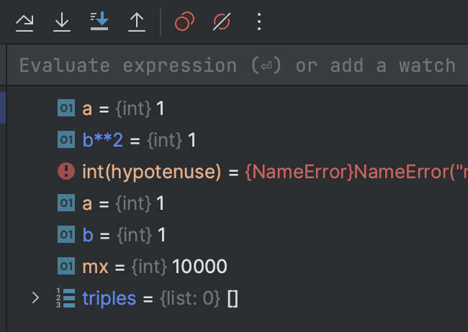
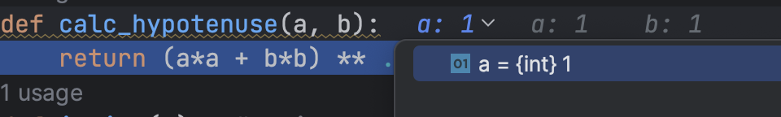
Watching
click the Step Into button , you will see that the debugger goes into the file
Rerun program in debug mode so you can watch your variables and expressions
Hover over variables in the editor to get inline debug info
Make sure that Show Variable Values in Editor is enabled.

Slide 19
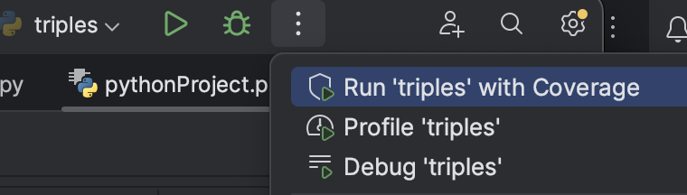
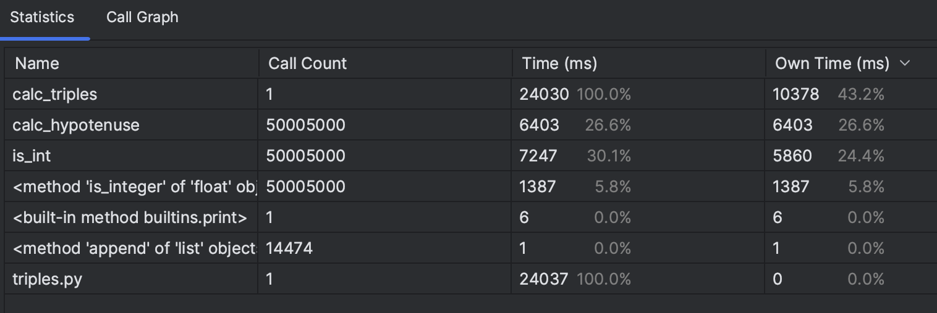
Pycharm Profiler
click the Step Into button , you will see that the debugger goes into the file
Pycharm has a builtin profiler
Click 3 dots at top and select Profile ‘triples’

